Slide 1

Desktop Assistant
User Manual
Author: B.Siddharth
Notes:
Preworks course home assignments

Slide 2
Table of Contents
Acknowledgements
About Me…
About My Internship Journey with Clevered.
About App…
How do I use the App?
Option Name
Contact Person

Slide 3
Acknowledgements
A small vote of thanks to all who have helped you in this journey of App Development –My parents, Ms. Shivani mam, Ms.Smita mam, Mr. Ken, Greeks for Greeks website.

Slide 4
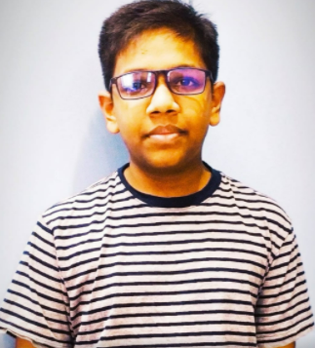
About Me..
My name is B.Siddharth I am studying in grade 9 and I am 14 years old.

Slide 5
About My Internship Journey with Clevered..
My Internship is worth and this will be a value-added step to my future in AI and related technologies I will be taking. Great opportunity to learn under the leadership of Mr. Ken who is from the world’s renowned Oxford University.

Slide 6
About App..
The app menu consist of several button with different functionalities including a HELP Button and a Settings Button
This app is a personal desktop assistant which can handle all domestic tasks.
This app can be controlled through button and voice

Slide 7
How do I use the App?

Slide 8
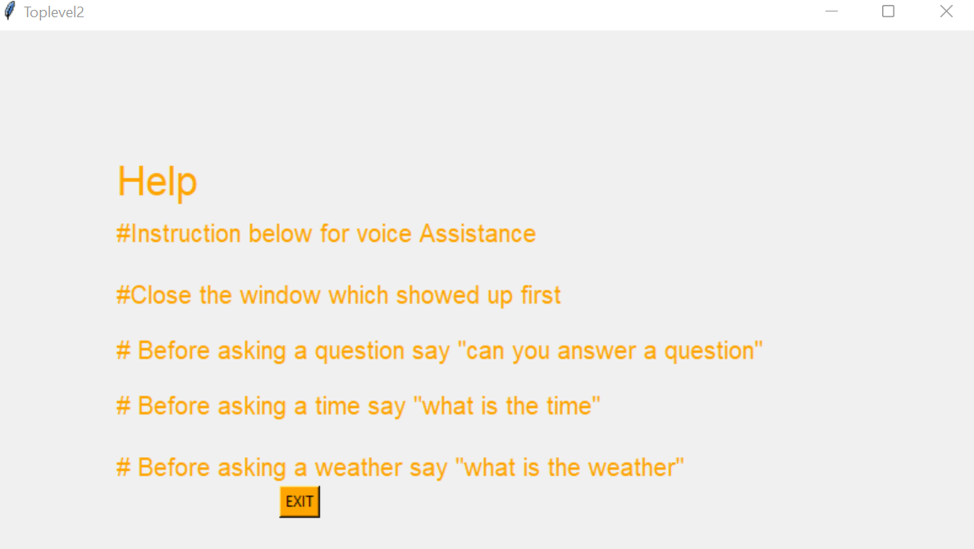
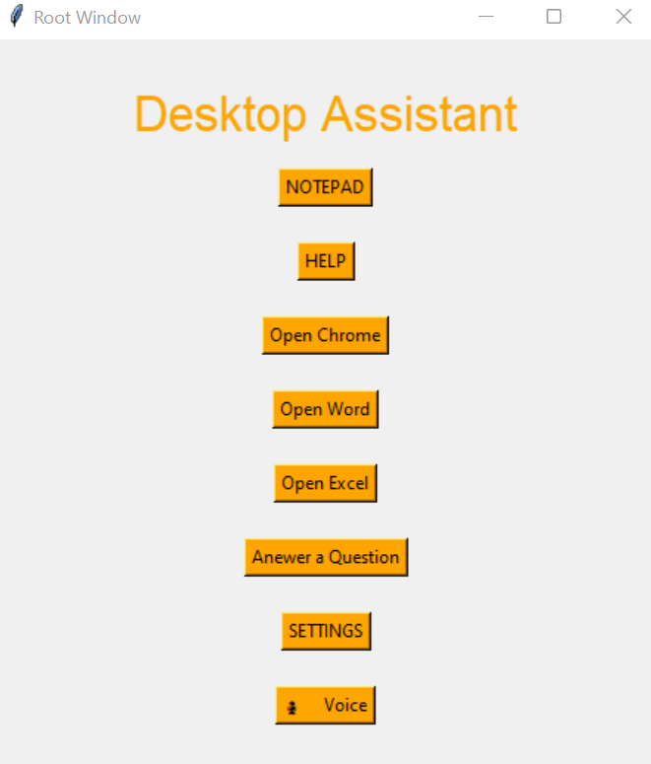
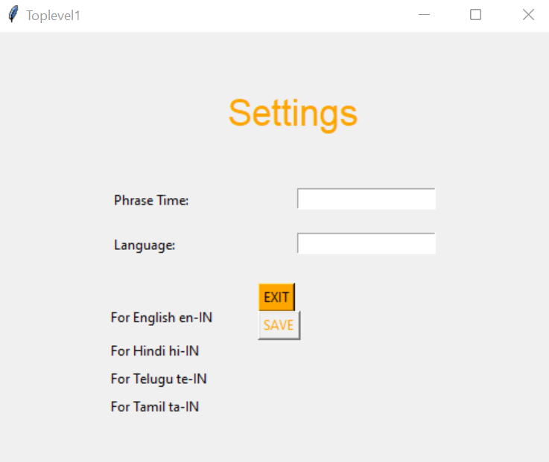
Option Name
There aren’t any special considerations other than using the appropriate commands.

Slide 9
Contact Person
If any difficulty, glitch or error please email to boddualsiddharth2908@gmail.com

Slide 10
Thank you!

